Slide 1
Can Crusher
IN 1900 ICT Project
Final Presentation
Group No :10

Slide 2





Group Members
 | Name | Reg. No: | Photo
Group Leader | Kanakkahewa Y.B. | 204092P
Member 1 | Nishath M.N.H.A | 204140M
Member 2 | Sanchitha S.P.Y.P | 204186H
Member 3 | Basnayake S.B. | 204020V
Member 4 | Kavinda K.A.R. | 204098N

Slide 3

Outline
Problem in Brief
Project Aim and Objectives
Input-Output Diagram
3D Diagram and Animation
Schematic Diagram of the System
PCB Design
Resources Used
Total Cost
Test and Implementation
Individual Contribution
Introduction

Slide 4
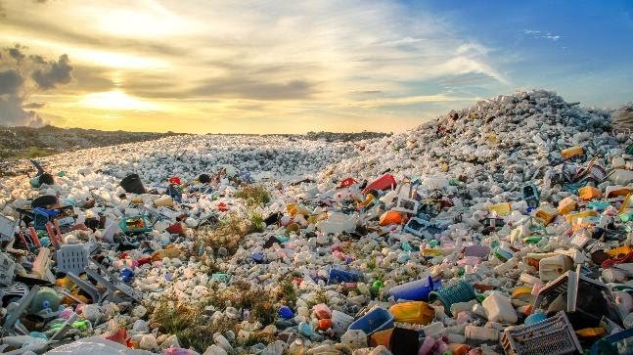
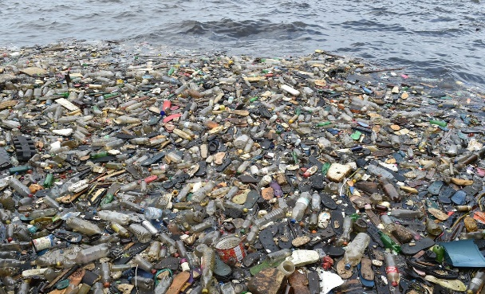
Introduction
The speedy globalization and the evolution of technology
has led the human race to a greater extent.
But with that, the environmental pollution has also
increased drastically.!
Disposed Plastics,
Metallic materials do a great harm to the earth.

Slide 5
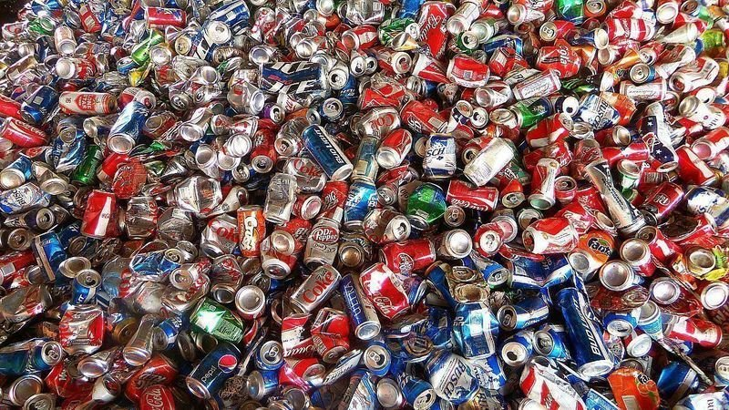
There are many ways to recycle and reuse the plastic materials,
but when it comes to metal,
specially Aluminium, there aren’t many techniques to recycle them.
So, we decided to make a solution.

Slide 6
Problem in brief
Nowadays lots of beverage companies use Aluminium cans as their main container for their beverages. And due to that there have been a huge increase of usage in Aluminium cans. But there are no proper ways of discarding them after they used in Sri Lanka. So, we saw this as an opportunity to provide an effective solution using proper technology.
So, the following are the issues we found in our research.
Aluminium cans have become an environmental disaster due to their overuse without recycling.
People tend to dispose Aluminium cans incorrectly because there isn’t a proper method to dispose them in an
environmentally friendly way.
It is very hard to categorize Aluminium cans from mix garbage for workers in a particular garbage collecting facility.
People tend to throwaway used Aluminium cans because they are considered as less valued items.

Slide 7
Project Aim & Objectives
Aim:
Develop an automated machine for dispose cans(ex-: beer cans , soft drink cans ) in a environmentally
friendly method.
Objectives:
Protecting ecosystems and wildlife while maintaining the beauty of the environment
Influence people, not to throw cans everywhere by using a rewarding can collecting method
Saving energy (Producing Aluminium from old products (old cans) uses less energy than making it from the scratch)
Conserving natural resources by reducing risky, expensive and damaging mining and extraction of new metal ores

Slide 8
Proposed Solution

Slide 9
Proposed Solution (Contd.)

Slide 10
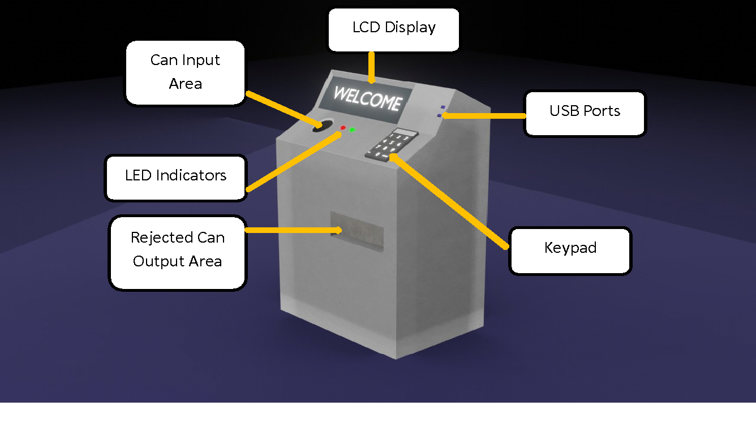
3D Diagram & Animation

Slide 11
Aluminium
Can
Rewarding Unit +
Processing Unit
Scanning Unit
Discarding Unit
Can Crushing Unit
Storing Unit

Slide 12
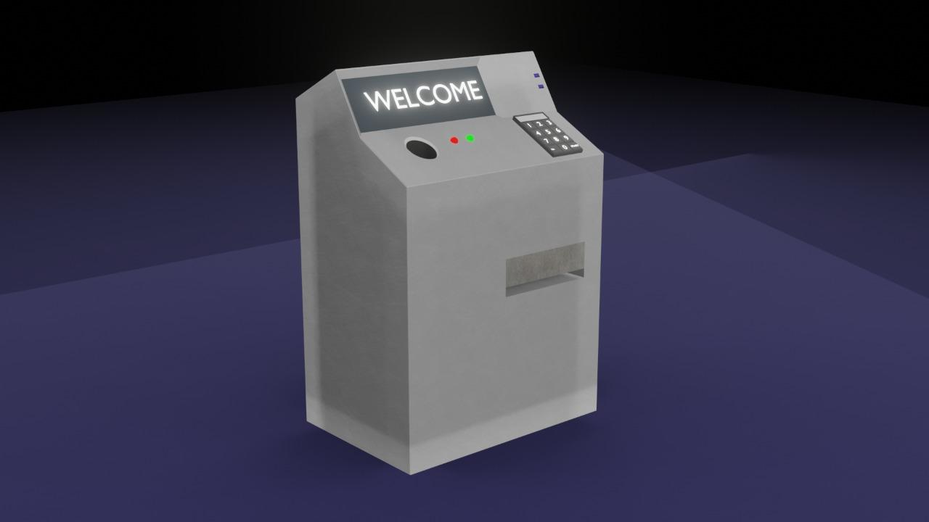
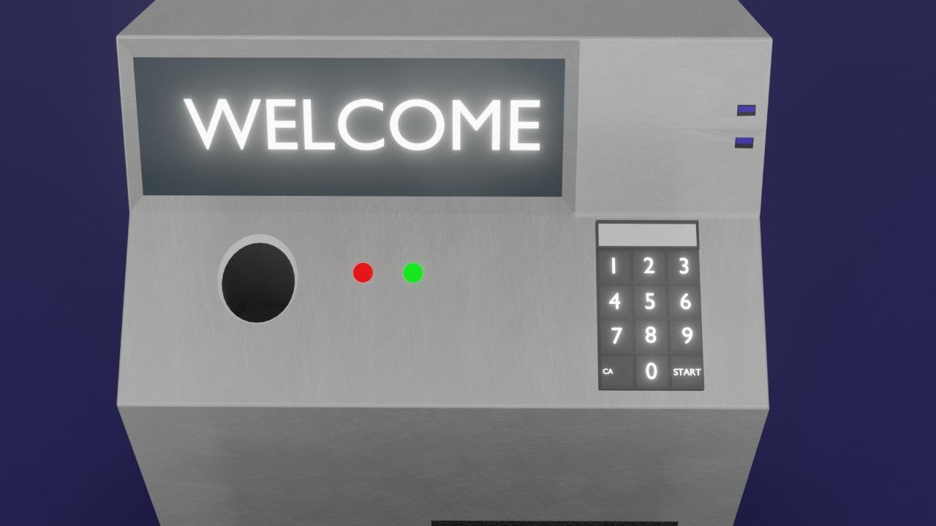
3D Diagram & Animation Contd

Slide 13
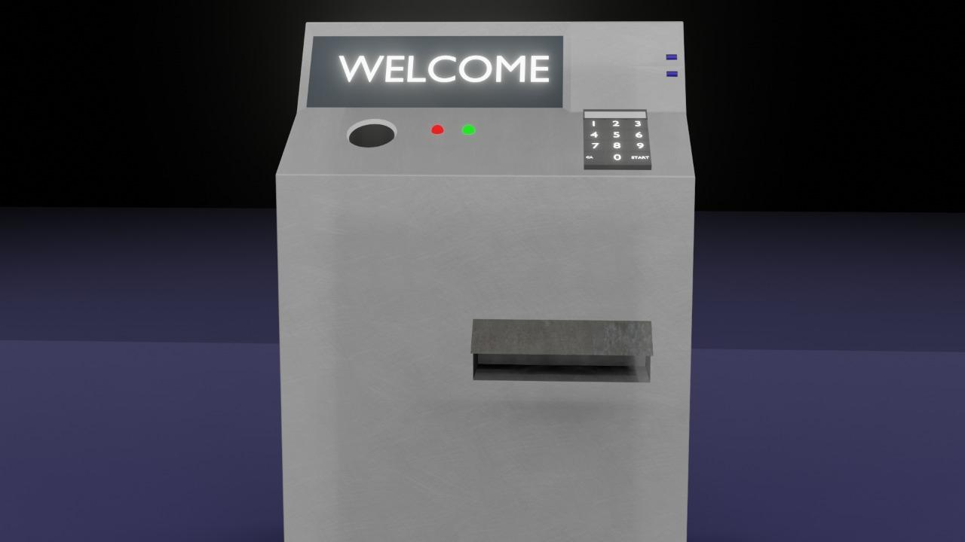
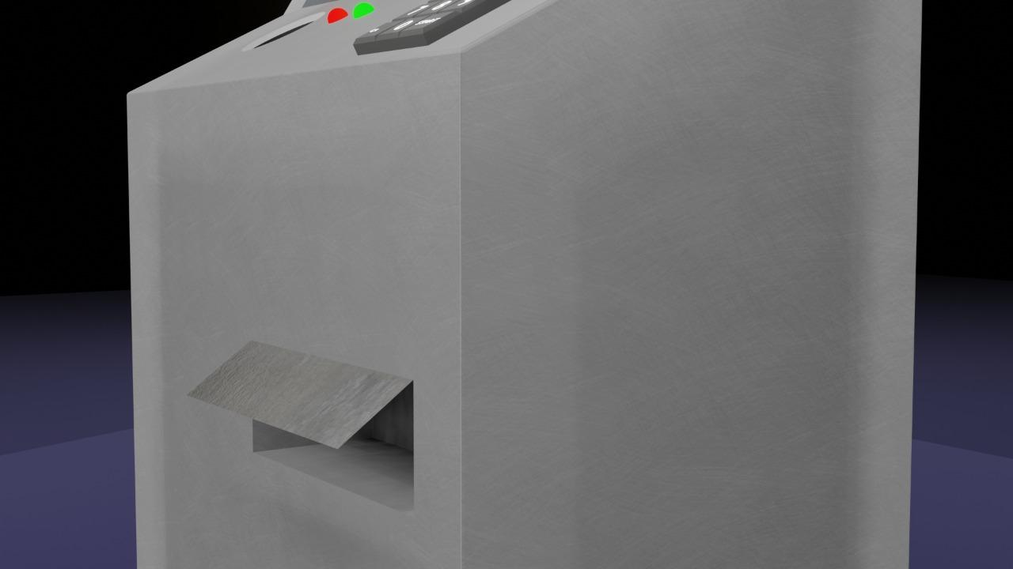
3D Diagram & Animation
3D Animation -: https://drive.google.com/file/d/1JA3QelDNrdeC8IEuw3bosfYbQJWoS_cH/view?usp=sharing
https://drive.google.com/file/d/1zpCiQJ7hfuIsDe9X8WB9kJTqfICxo74r/view?usp=sharing

Slide 14
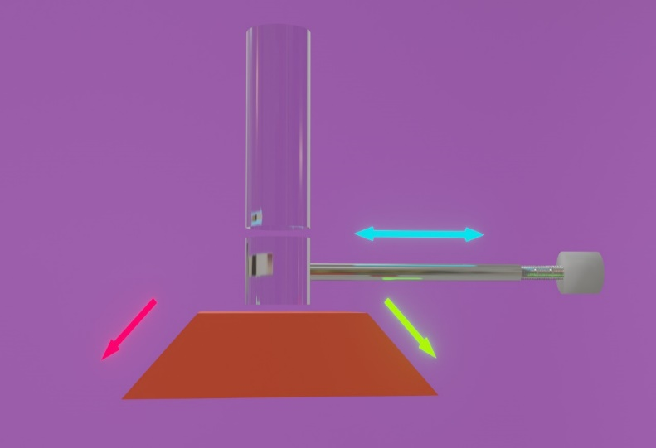
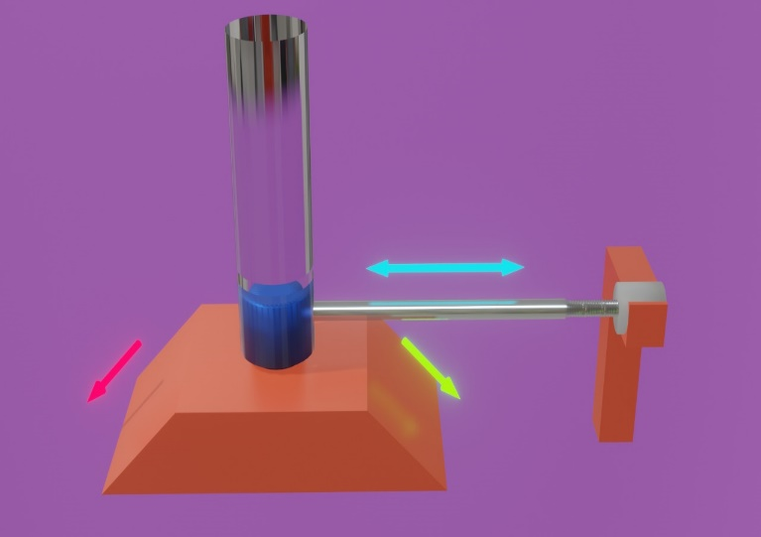
Scanning Unit
The sensors that are used to check the user’s inputs are housed in this machine. If a proper can is identified then it is sent to crushing unit. If not it is sent to Discard Unit.
Stepper Motor
Ultrasonic Sensor
IR Sensor + Inductive Proximity Sensor
Weight Sensor

Slide 15
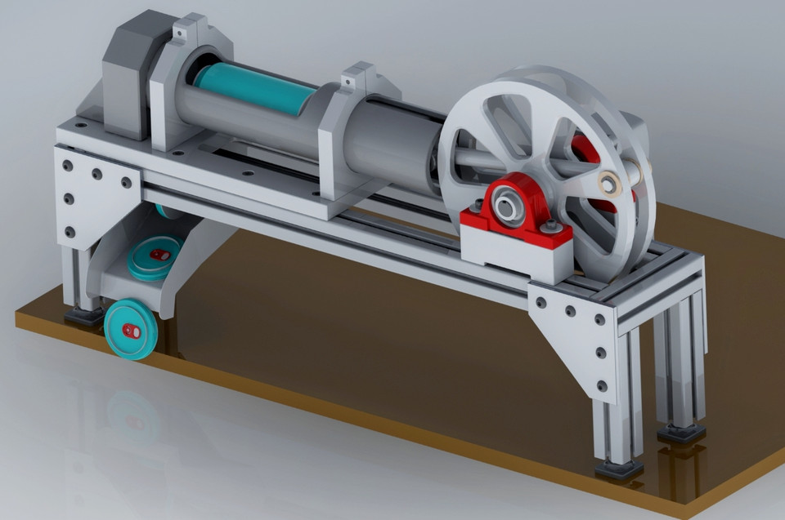
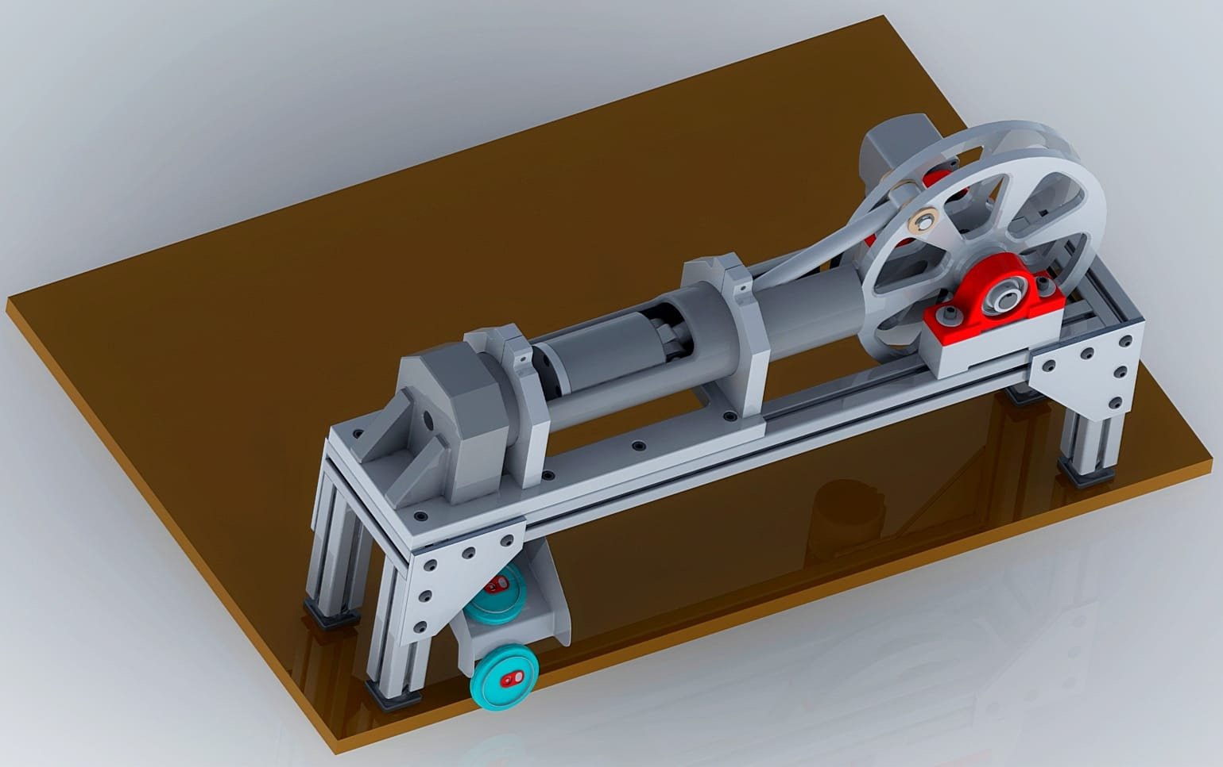
Crushing Unit
The identified cans are crushed using a crushing mechanism.
Induction Motor
Aluminum Can

Slide 16


Storing Unit
The crushed cans are stored in a bin. When the bin is filled to a designated weight limit the machine lights an indicator and sends a SMS to the worker to indicate this. Then a worker will empty the bin and prepare the machine for the next couple of weeks.
IR
Sensor
Crushed Cans
Can Storing bin has reached its maximum capacity!!!

Slide 17
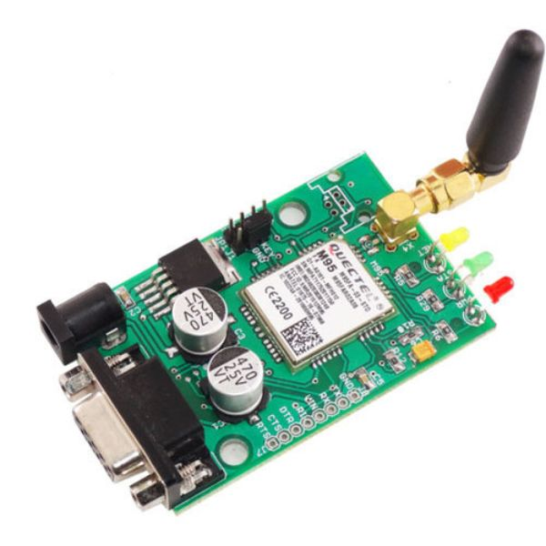
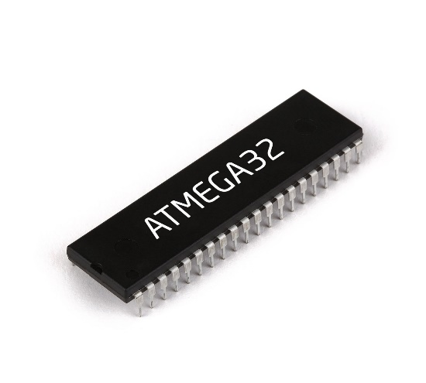
Processing Unit
Microcontroller ,GSM modules and all the other processing related units are housed in here..

Slide 18


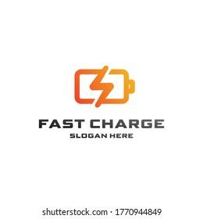
Rewarding Unit
After the user successfully entered cans to the machine, then the machine will offer a mobile reload or a fast charging time according to the total value of the cans. And also the user can donate the value to the Little Hearts foundation.

Slide 19
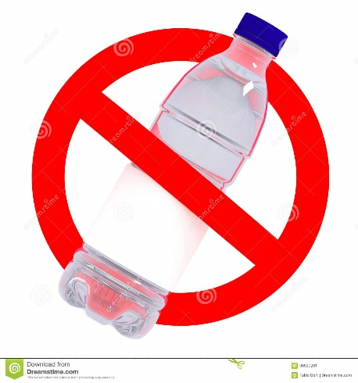
Discarding Unit
The rejected cans are sent back to the user. A red LED is lighted and a notification alert
is sounded in order to show that the input has been rejected.

Slide 20
Schematic Diagram

Slide 21
Power Supply

Slide 22
PCB Design

Slide 23
Power Supply

Slide 24





Resource Required
Software:
Microchip Studio
Proteus
Github
Blender
Kicad

Slide 25
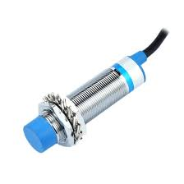
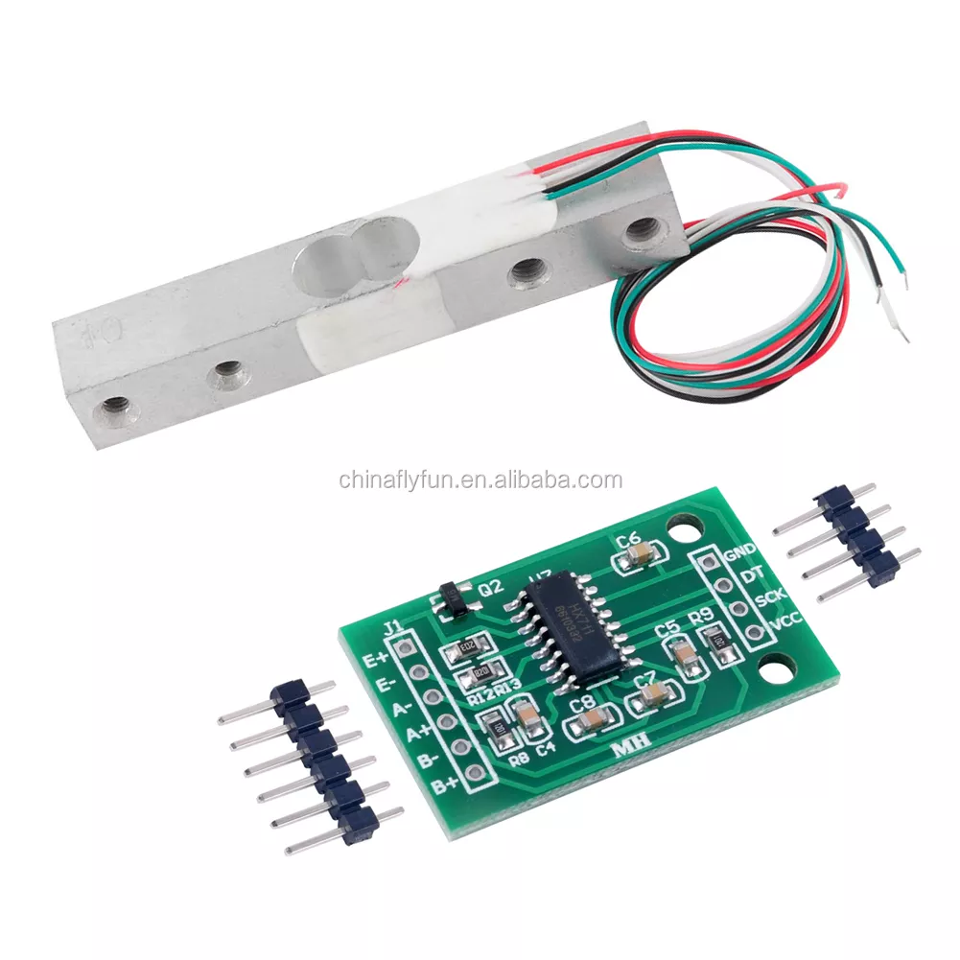
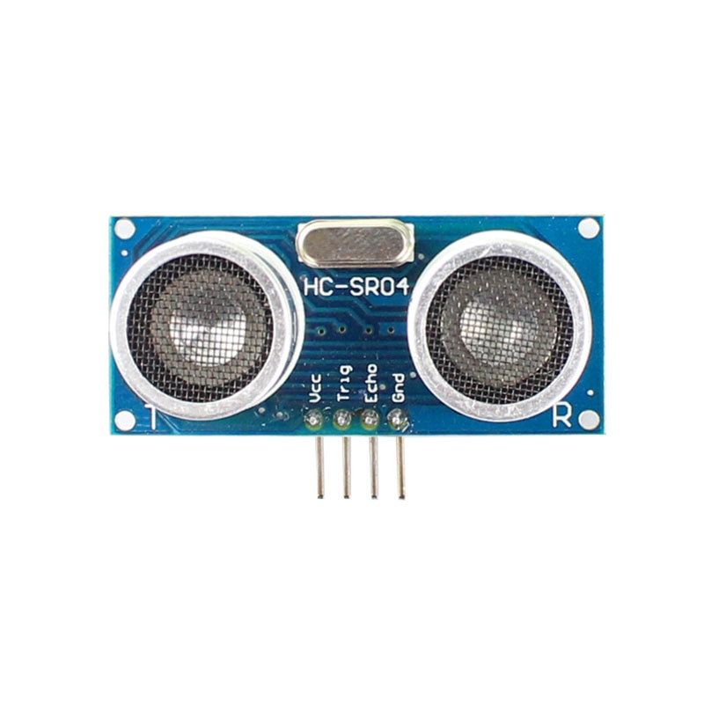
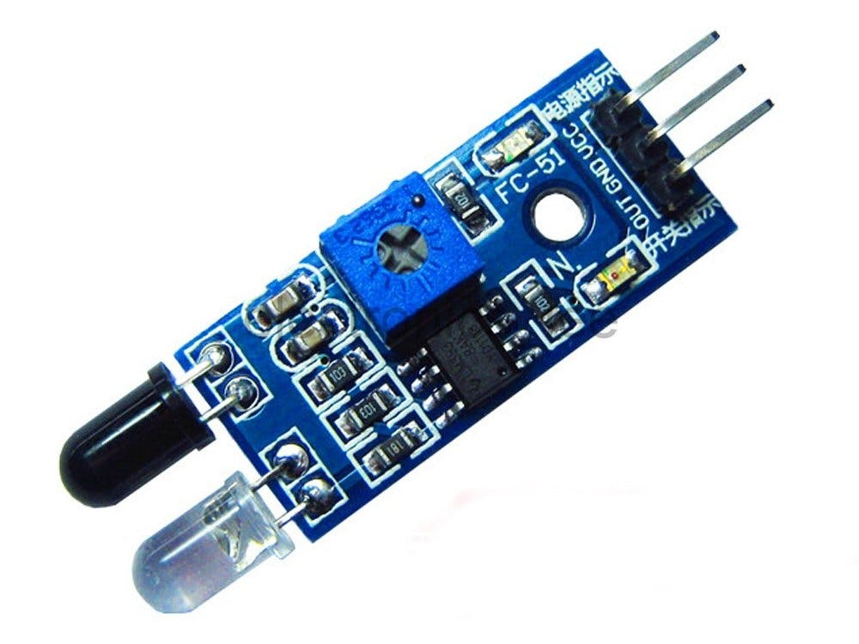
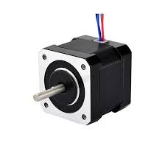

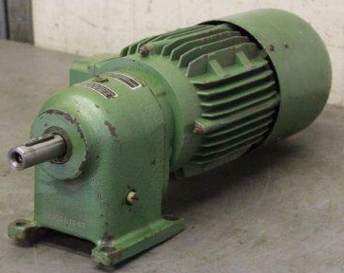
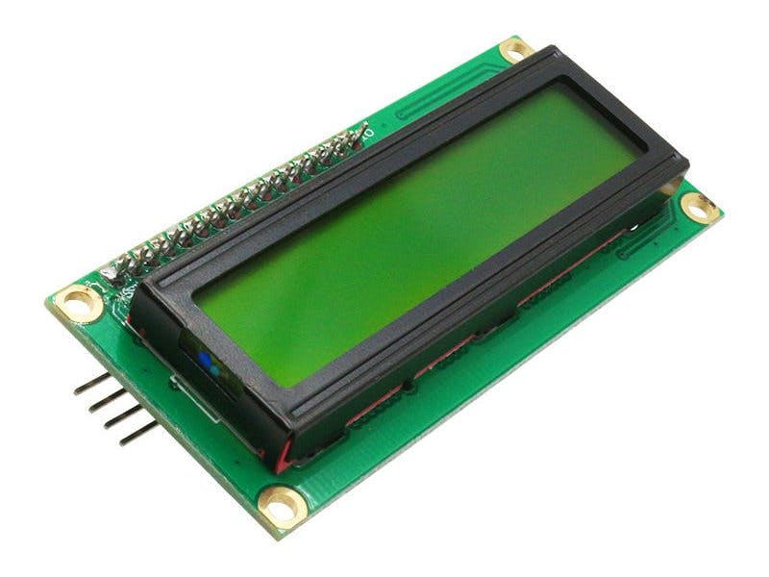
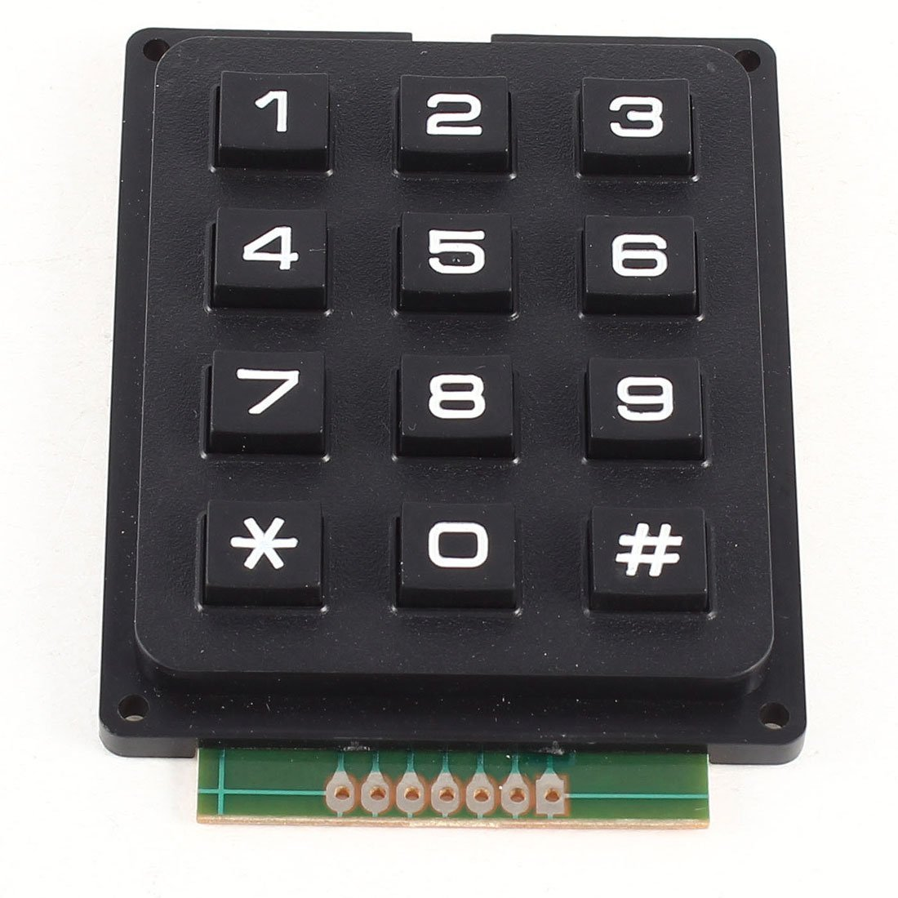
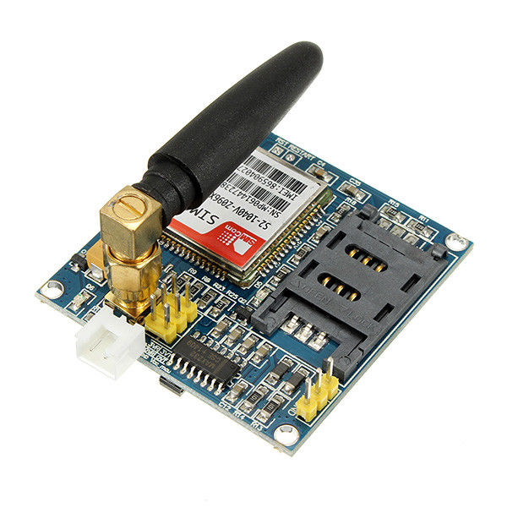
Resource Required (Hardware)
Inductive Proximity Sensor IR Sensor Weight Sensor Ultrasonic Sensor
Microcontroller: Atmega32 Stepper Motor Servo Motor Induction Motor
LCD Display Keypad USB Module GSM Module

Slide 26
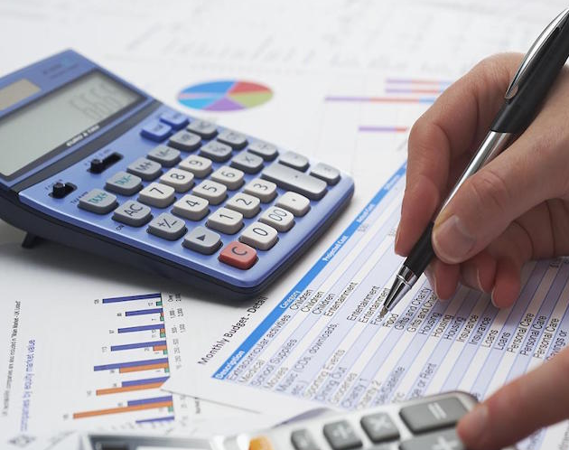
Cost Estimation

Slide 27
Name | Unit Price (Rs.) | Quantity | Total Price (Rs.)
1602 16x2 Blue Backlight LCD Display | 800 | 2 | 1600
4x4 16-Key Membrane Switch Keypad Module | 200 | 1 | 200
Load Cell | 610.00 | 1 | 610
Load cell 10g + hx711 | 1,110.00 | 1 | 1,110
Analog Servo Motor Metal Wheel ES08MA-II Full Set | 1440 | 2 | 2880
A6 GSM GPRS Quad-band Module with Antenna | 2380 | 1 | 2380
3V Mini Buzzer | 60 | 1 | 60
Atmega 32 microcontroller | 2020 | 2 | 2020
Line Hunting Sensor Module with Preset 3-pin TCRT5000 (IR Sensor) | 280 | 2 | 560
LJ18A3-8-Z/AX 8mm NPN NC DC Inductive Proximity Sensor | 1944 | 1 | 1944
Nema 17 1.8° 42mm 0.44N.M 1.7A Stepper Motor | 4432 | 1 | 4432
HC-SR04 Ultrasonic Sensor | 400 | 1 | 400
Induction Motor | 15000 | 1 | 15000
TOTAL |  |  | 33196

Slide 28

Testing and Implementation

Slide 29
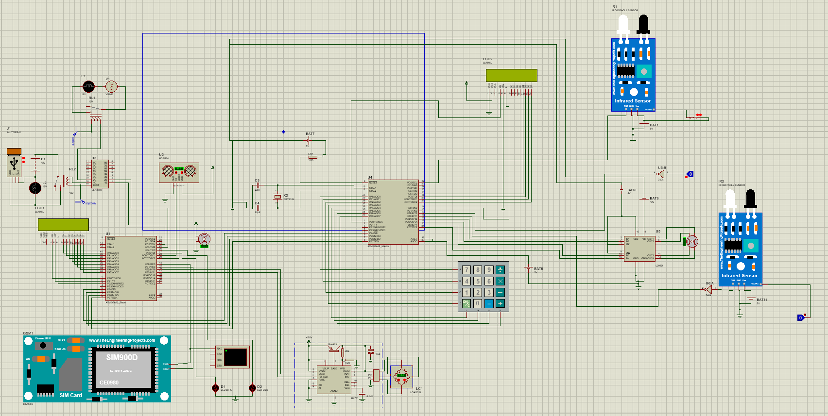

Slide 30

Individual Contribution

